Slide 1
Use of RFID in Libraries with Integration ILMS
Presented by:
Dr. Nakul Chandra Mondal, Librarian
Hooghly Engineering & Technology College
Date: 4th Sepeember,2025

Slide 2
Introduction to Modern Library Technologies
Libraries are undergoing a significant digital transformation, embracing a range of modern technologies to enhance their services and operational efficiency.
From streamlining material management with RFID to personalizing user experiences with AI and cloud-based systems, technology is reshaping the traditional library model.
Mobile applications provide convenient access to resources on the go, while the Internet of Things (IoT) enables smarter, more responsive library spaces.
Emerging technologies like blockchain are also being explored for secure data management and transparent record-keeping, pushing the boundaries of what a library can be.

Slide 3
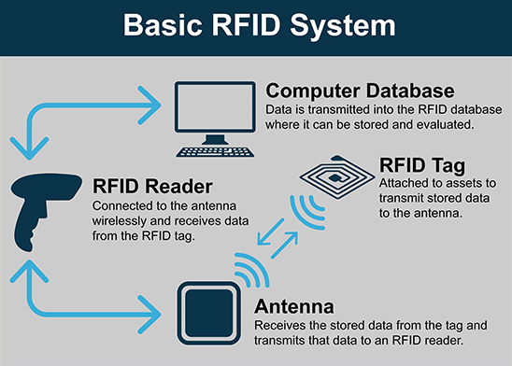
What is RFID? (Core Concept)
Radio Frequency Identification (RFID) is a technology that uses radio waves to wirelessly identify and track objects, enabling automated data capture.
Unlike barcodes, RFID doesn't require a direct line of sight between the tag and the reader, allowing for faster and more efficient identification of multiple items simultaneously.
Key Components of an RFID System:
RFID Tags: Also known as transponders, these small devices contain a microchip (integrated circuit) and an antenna. The microchip stores unique identifying information. Tags can be passive (powered by the reader's radio waves) or active (self-powered, offering longer read ranges).
RFID Readers: Sometimes called interrogators, these devices emit radio waves to activate and read data from RFID tags. They then convert this information into digital data for processing by computer systems or Integrated Library Systems (ILS).
Antenna: Antenna are crucial components in an RFID system, responsible for transmitting and receiving radio frequency signals between the RFID reader and tags.
The core process involves the reader sending a signal, which the tag receives and instantly responds to by transmitting its unique identification number. This rapid exchange facilitates quick and accurate data collection.

Slide 4
Why RFID in Libraries? (Key Drivers)
Faster Check-In/Check-Out: RFID significantly reduces the time required for lending and returning materials, as multiple items can be processed simultaneously without opening books or scanning individual barcodes.
Efficient Inventory Management: Librarians can quickly and accurately conduct inventory checks by simply walking through aisles with a handheld RFID reader, making stocktaking a much less labor-intensive task.
Enhanced Anti-Theft Security: RFID tags can be linked to security gates at exits, triggering an alarm if unauthorized materials are taken, providing a more robust anti-theft system than traditional methods.
Empowering Self-Service Capabilities: RFID enables patrons to use self-check kiosks for borrowing and returning books independently, improving convenience and reducing queues at service desks.
Accurate Data Tracking: The technology provides highly reliable data on item location and status, leading to better insights for collection management and usage patterns.
Improved Staff Efficiency: By automating routine tasks like sorting, checking, and shelving, RFID frees up library staff to focus on more complex services, user support, and programming.
Seamless Automation & Integration: RFID systems are designed to integrate smoothly with existing Integrated Library Systems (ILS) like libsys soul or Koha, enabling a higher degree of automation in various library operations.

Slide 5
Core Benefits of RFID (Part 1: Efficiency & Security)
Faster Checkouts: Quickly borrow and return items.
Easy Tracking: Know where library items are in real-time.
Better Security: Help prevent theft of materials.
Automated Tasks: Many routine library operations become automatic.

Slide 6
Core Benefits of RFID (Part 2: User & Staff Experience)
Self-check kiosks: Empower patrons with convenient, independent borrowing and returning.
Reduced queues: Drastically cut waiting times at service desks for a smoother experience.
Less manual work for staff: Free up library personnel from repetitive tasks to focus on user assistance and programming.

Slide 7
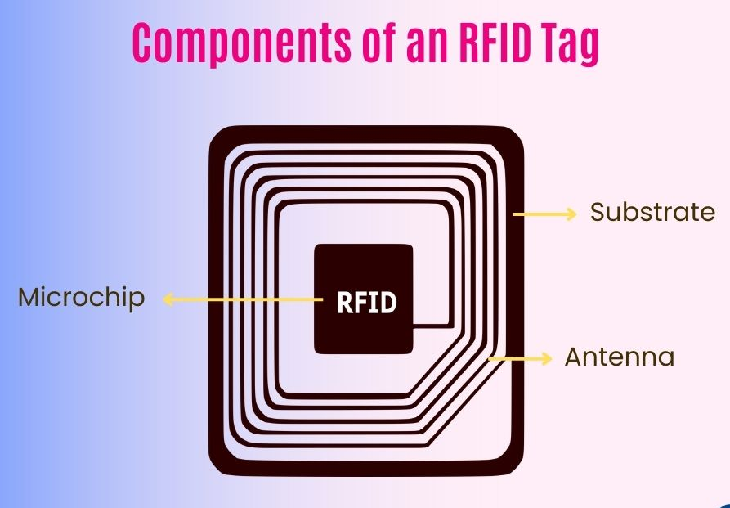
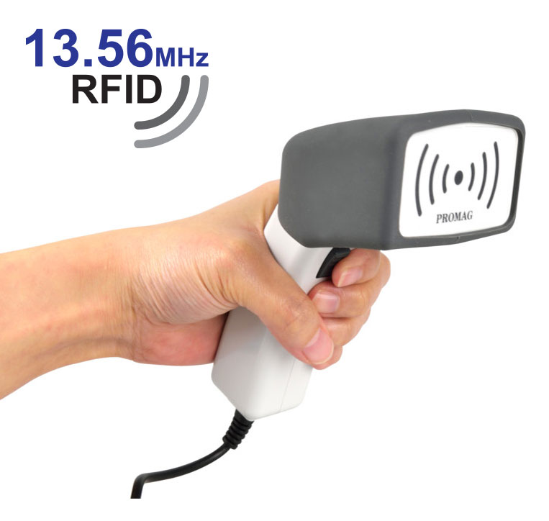
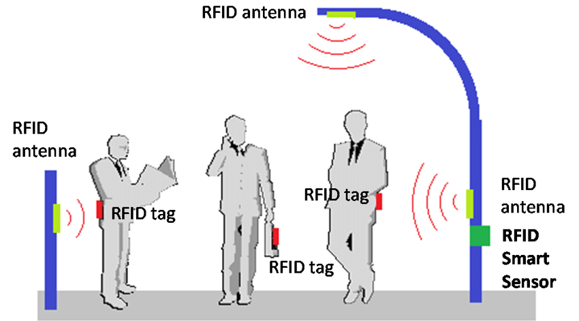
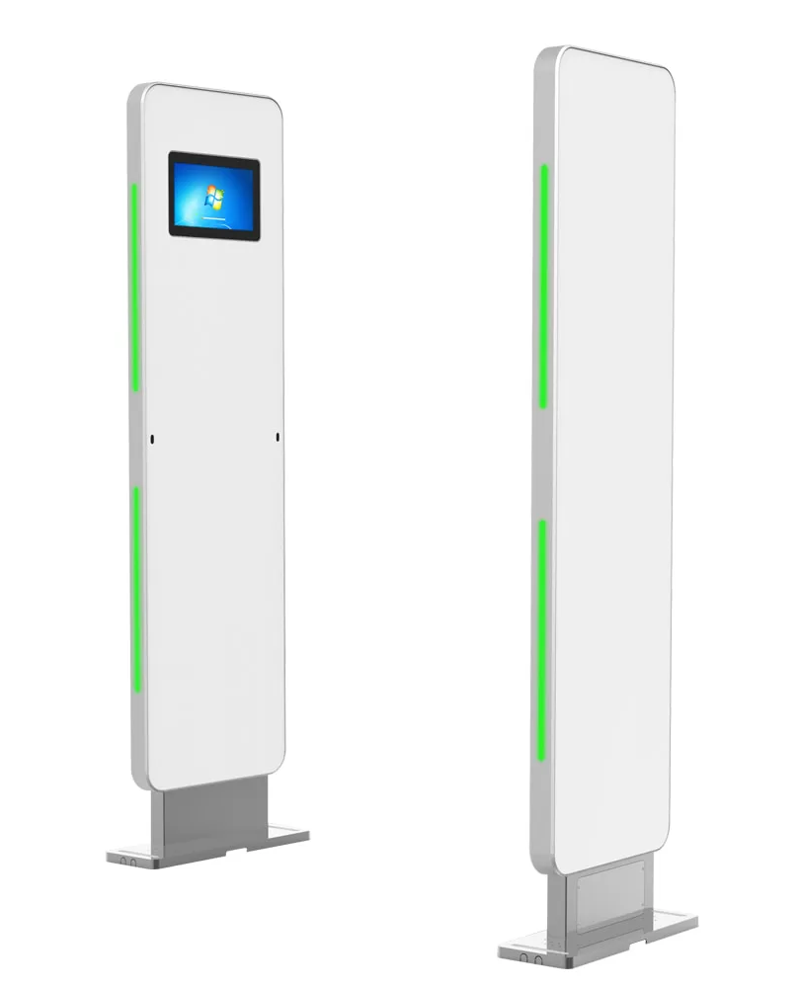
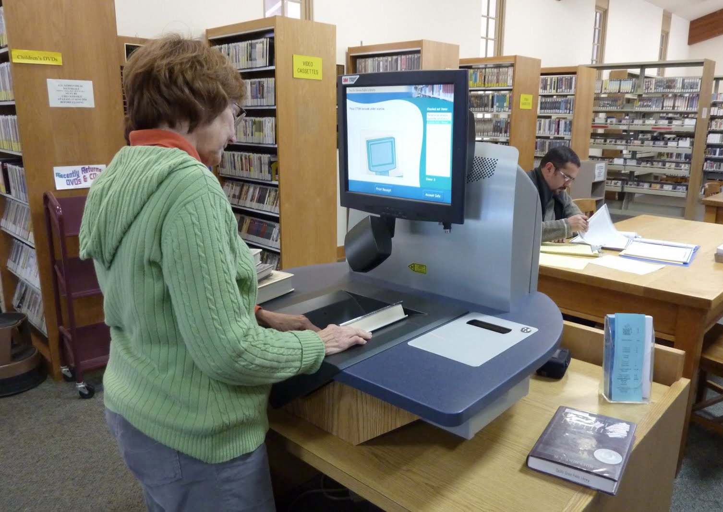
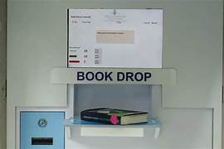
Hardware Components of an RFID System
RFID Readers
RFID Antennas
RFID Tags
Transmit and receive radio signals for tags.
Tiny devices storing unique item data.
Devices that read data from RFID tags.
RFID Security Gates
Self-Check Kiosks
RFID Bookdrop
Prevent unauthorized item removal.
Enable patron self-service for borrowing.
Automated return system for library items.

Slide 8
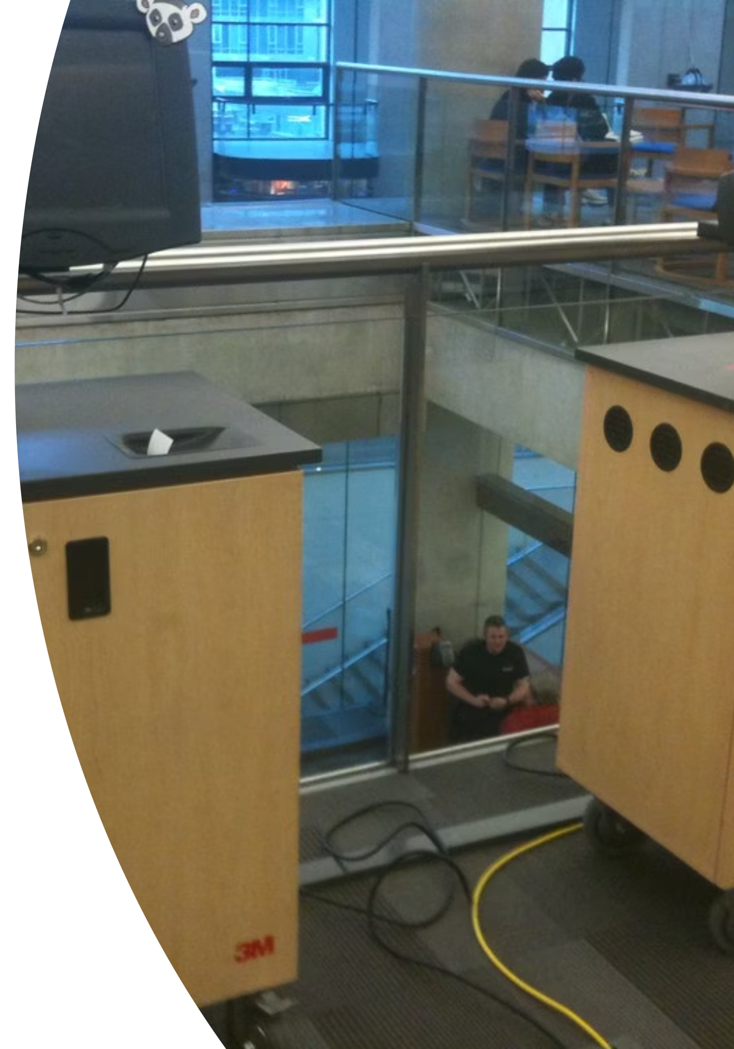
Software & Integration Components
RFID Software
This is the dedicated application that controls and manages the RFID hardware (readers, antennas) and processes the data captured from RFID tags, handling tasks like encoding tags and managing security settings.
Middleware
Serves as a crucial bridge, translating data between the RFID hardware and the Integrated Library System (ILS). It ensures seamless communication and data exchange, allowing different systems to "talk" to each other effectively.
Integration with Library Management System (LMS)
This is the critical step where RFID data is integrated directly into the library's primary management system (like Koha). This allows real-time updates of item status, patron records, and inventory data within the ILS.
User Interface (UI)
Provides the graphical interface for both library staff and patrons to interact with the RFID system. This includes interfaces for self-check kiosks, staff workstations, and inventory management tools, making the technology accessible and user-friendly.

Slide 9
Introduction to Koha ILS
Koha stands as the world's first free and open-source Integrated Library System (ILS), designed to manage all aspects of library operations. It was originally developed in New Zealand and has since grown into a robust, community-driven project.
It offers a comprehensive suite of modules including professional cataloging (supporting MARC21 and UNIMARC standards), efficient circulation management for loans, returns, and patron accounts, a user-friendly Online Public Access Catalog (OPAC) for patron searching and account management, and powerful reporting tools for usage statistics and collection analysis. Additional features include acquisitions, serials control, and patron management.
Koha is highly flexible and cloud-compatible, allowing libraries to deploy it on local servers or in various cloud environments. Its open-source nature means it is constantly evolving with contributions from a global community of developers and librarians, ensuring it remains current with emerging library needs and technologies.
Globally adopted, Koha is used by thousands of libraries of all types and sizes – from small public libraries to large academic institutions – in over 100 countries, showcasing its versatility and suitability for diverse library ecosystems.

Slide 10





The Power of Integration: RFID + Koha (Workflow)
The seamless integration of RFID technology with Koha ILS streamlines various library workflows, enhancing efficiency for both staff and patrons. This powerful synergy automates key processes and ensures real-time data accuracy.
Self Check-In/Out
Update Koha
Patrons use RFID kiosks for transactions
Real-time inventory and patron record updates
Tag Items
Middleware Relay
Attach RFID tags and link to Koha records
Translate RFID events to Koha-compatible data

Slide 11
The Power of Integration: RFID + Koha (Technical)
Middleware as the Bridge: Middleware acts as the crucial intermediary, translating the raw data from RFID readers and hardware into a format that Koha can understand and process, ensuring seamless communication between physical RFID devices and the ILS.
Real-time Data Synchronization: RFID transactions (e.g., check-ins, check-outs, inventory scans) instantly update the Koha database, ensuring that item statuses, patron records, and collection data are always current and accurate across the system.
API-driven Integration: The integration often leverages Application Programming Interfaces (APIs) provided by Koha, allowing the RFID middleware to programmatically interact with the ILS for efficient and reliable data exchange, avoiding manual data entry and reducing errors.

Slide 12
Implementation Models & Challenges
RFID Implementation Models
Basic RFID (Small Libraries)
Advanced RFID (Medium Libraries)
Advanced RFID with Surveillance (Large Libraries)
Focuses on core functionalities like self-checkout and basic security, providing an accessible entry point for smaller libraries with limited budgets and simpler operational needs.
Expands on basic features to include inventory management, item tracking, and staff workstation integration, enhancing efficiency for libraries with larger collections and more complex workflows.
Incorporates comprehensive security measures such as advanced anti-theft gates and robust patron privacy controls, designed for high-traffic institutions with extensive collections requiring heightened security and data management.
Key Challenges
High Initial Investment: The upfront costs for RFID tags, readers, security gates, and software can be substantial, requiring careful budgetary planning.
Technical Integration Complexities: Ensuring seamless data exchange and compatibility between the RFID system and existing Library Management Systems (LMS) can present technical hurdles.
Privacy and Data Security: Concerns regarding the tracking of library materials and patron data necessitate robust policies and transparent practices to address privacy expectations and comply with regulations.

Slide 13
Conclusion: The Future Library
The integration of RFID technology with Koha ILS represents a significant leap forward in creating truly smart and efficient libraries. This powerful synergy transforms traditional library operations, fostering a more dynamic and responsive environment for both staff and patrons.
The combined benefits are profound: dramatically increased speed in circulation and inventory processes, unparalleled accuracy in data management, robust security for collection protection, and ultimately, elevated user satisfaction through seamless self-service options and improved access to resources.
Embracing this integration positions libraries at the forefront of innovation, ensuring they remain vibrant, accessible, and technologically advanced hubs for knowledge and community engagement in the future.

Slide 14
Q&A / Thank You
Any Questions?
Thank you for your attention!

